Slide 1
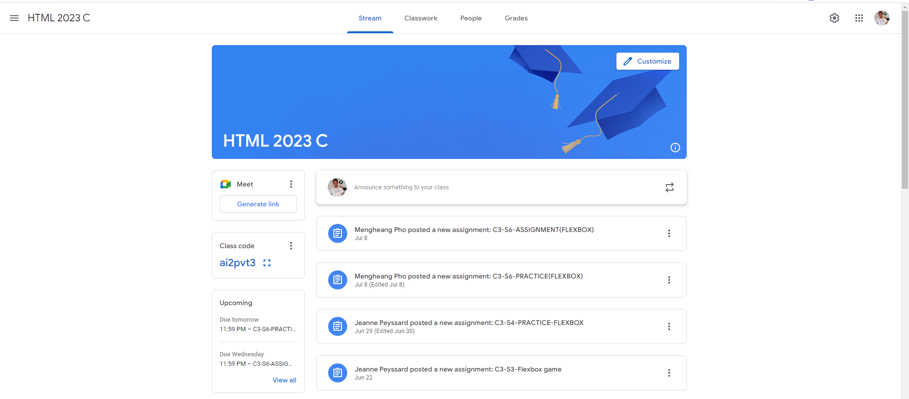
Identify root components of website below

Slide 2
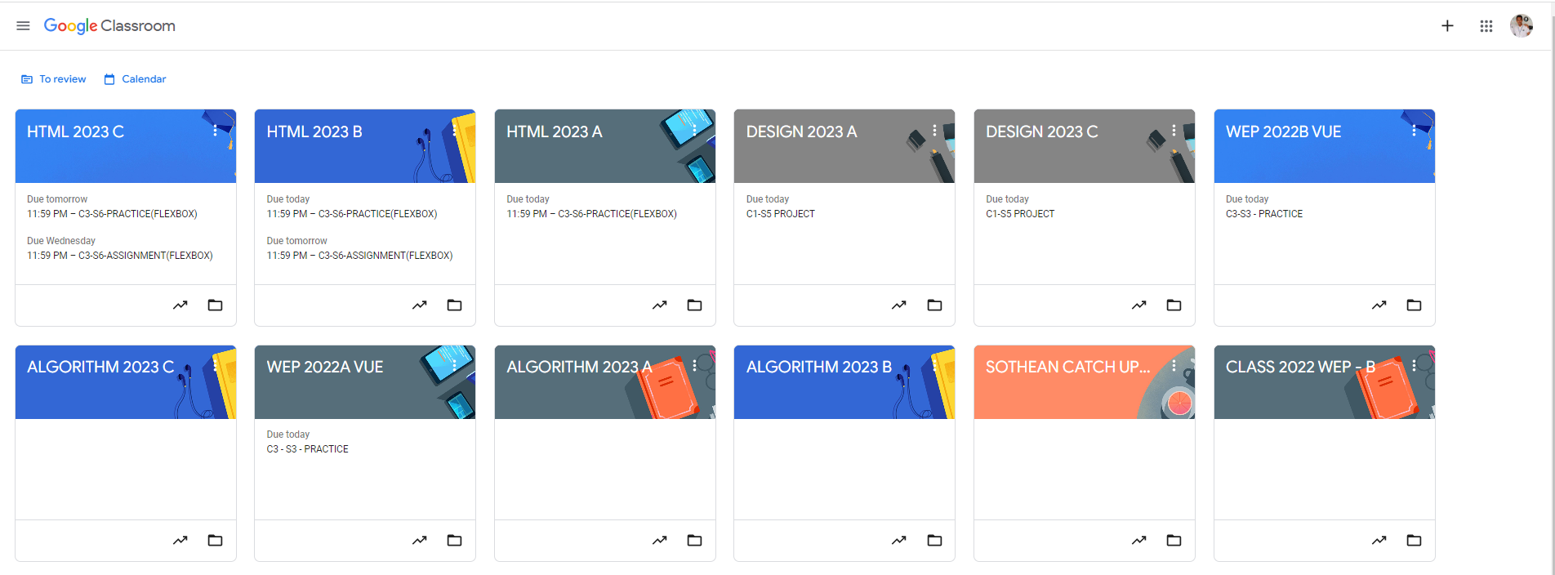
Root div
- Height: 100vh
content
nav
Flex: 0
header
Flex: 0
Flex: 1

Slide 3
Answer:
Root container:
- Class: root
- Properties:
.root{
display: flex;
flex-direction: column;
height: 100vh;
}
3. Header:
- Class: header
- Properties:
.header{
flex: 0;
}
5. Sidebar:
- Class: sidebar
- Properties:
.sidebar{
flex: 0;
}
2. Navigation Bar:
- Class: nav-bar
- Properties:
.nav-bar{
flex: 0;
}
4. Content Container:
- Class: content
- Properties:
.content{
flex: 1;
flex-direction: row;
display: flex;
}
6. Main content area:
- Class: main-content
- Properties:
.main-content{
flex: 1;
}

Slide 4


Navigation
Left-nav
Center-nav
Right-nav
Header
Root
Main content
Section1
Section2
Content

